Slide 1
Software-Defined Networking for 5G Security
AlexandruM
Group 410

Slide 2
5G security architecture

Slide 3
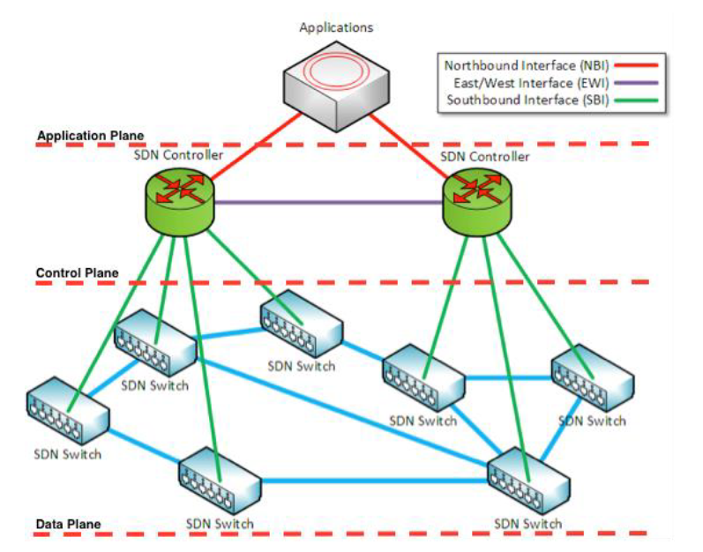
SDN
a paradigm for networking architecture;
decouples the data (forwarding) plane and control plane;
brings simplicity, programability and elasticity.
Software Defined Networking
Software Defined Networking diagram in [1]

Slide 4
SDN Advantages for 5G security
Network-Wide Intrusion Detection;
Detection of Malicious Switch Behavior;
Network Forensics;
Access control.
SDN characteristic | Attributed to | Security use
Global network view | • Centralization • Traffic statistics collection | • Network-wide intrusion detection • Detection of switch’s malicious behavior • Network forensics
Increased control capabilities | • Flow-based forwarding scheme | • Access control
Security pros over traditional networks [2]

Slide 5
5G SDN SECURITY THREATS

Slide 6
Summary of threats and countermeasures [2]
Targeted level | Malicious behavior | Caused by | Possible countermeasures
Data (forwarding) plane | Switch DoS | • Limited forwarding table storage capacity; • Enormous number of flows; • Limited switch’s buffering capacity. | • Proactive rule caching; • Rule aggregation; • Increasing switch’s buffering capacity; • Decreasing switch-controller communication delay (clusters).
Control plane | DDoS attack | • Centralization; • Limited forwarding table storage capacity; • Enormous number of flows. | • Controller replication; • Dynamic master controller assignment; • Efficient controller placement (in a cluster).
 | Compromised controller attacks | • Centralization | • Controller replication with diversity; • Efficient controller assignments.
Forwarding-control link | Man-in-the-middle attacks | • Communication messages sent in clear; • Lack of authentication. | • Encryption; • Use of digital signatures.
 | Replay attacks | • Communication messages sent in clear; • Lack of timestamping. | • Encryption; • Timestamp inclusion in encrypted messages.

Slide 7
Thank you for your attention!

Slide 8
Bibliography: 1) https://www.enisa.europa.eu/publications/sdn-threat-landscape; 2) Dabbagh, Mehiar, et al. "Software-defined networking security: pros and cons." IEEE Communications Magazine 53.6 (2015): 73-79; 3) Ji, Xinsheng, et al. "Overview of 5G security technology." Science China Information Sciences 61.8 (2018): 1-25; 4) S. K. Routray and K. P. Sharmila, "Software defined networking for 5G," 2017 4th International Conference on Advanced Computing and Communication Systems (ICACCS), 2017, pp. 1-5, doi: 10.1109/ICACCS.2017.8014576.

